Slide 1



Practical and Emotional Support Skills
Session Five
21st April 2021
Women’s Workshop:
New approaches to learning and support

Slide 2


Session 3 Outline
Welcome
  Quality Assurance Framework
  Confidentiality and Data Protection and good practice guidelines.
  Risk Assessment
  What Next?

Slide 3
Introductions
Round the group:
One thing you are particularly looking forward to coming out of Lockdown, personally or in your work.
Please chose someone else to speak next.

Slide 4
Today’s Learning Objectives
Developing Interaction Skills for IAG:
4.1 Describe how principles of confidentiality and data protection are adhered to in interaction with clients.
4.2. Describe how impartiality in service delivery is maintained.
IAG in Practice:
3.1 Describe boundaries of own role in meeting information, advice or guidance requirements of clients.
3.2 Give examples of a range of potential agencies for referral or signposting.
3.3 Describe how to refer or signpost individual clients to other agencies.
3.4 Describe how to monitor and evaluate client referrals to other agencies.

Slide 5
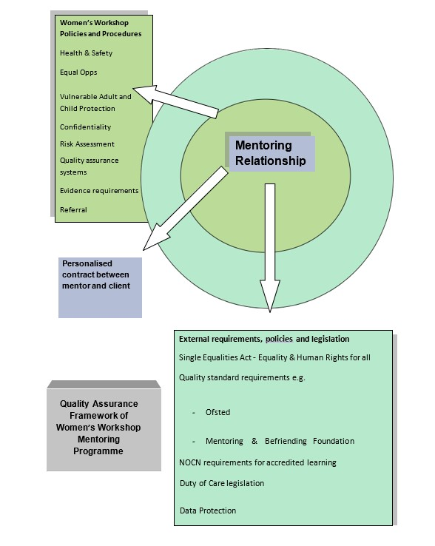
The framework for good practice in mentoring
Three layers…
External
Organisation
Individual

Slide 6

External requirements, policies and legislation
Single Equalities Act
Human Rights
Duty of care legislation
Mentoring & Befriending Foundation
NOCN requirements for accredited learning
Data Protection
Companies House
We will share all relevant issues throughout the course

Slide 7
Women’s Workshop Policies and Procedures
Health & Safety
Equal Opportunities
Vulnerable Adult Protection
Confidentiality
Risk Assessment
Quality assurance systems
Mentoring Handbook
Referral Systems
In your Centre information folder
On our website

Slide 8
Establishing a Personalised Contract in a Mentoring relationship
Negotiate:
  Access
  Boundaries
  Risk Assessment
Contract

Slide 9
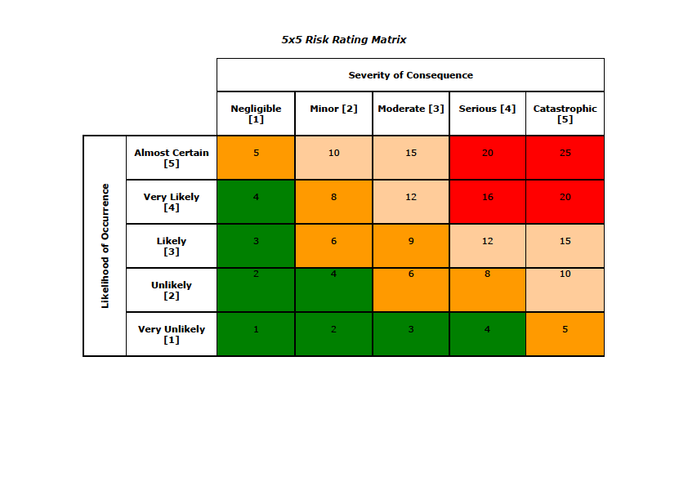
Accessing Risk!
Decide to exclude and refer
Reduce her involvement to low risk activities only and limit contact with others
Maintain involvement but limit contact with others or develop other plans to ensure saftey of others
Report risk incident to staff team for action including safeguarding action if needed
Identify named mentor with responsibility for ensuring safety with and by client
Agree general safe systems of work for staff , vols and clients for each activity by carrying out activity risk assessment

Slide 10
Case Study – ‘Yasmin’
Made redundant March 20
Only has access on a phone to online services
Needed to sign up to Universal Credit online in Covid i.e. couldn’t meet inside
English second language
Wanted to continue to be a care worker
Isolated – out of touch with people with shared culture / beliefs
Moved flat Oct 2020
Got Covid Feb 2021
Poor conditions in new care job – 60 hour weeks then laid off

Slide 11
Case Study – ‘Cheryl’
Living rurally, dependent on others for transport
In work provided by family business
Good at maths and accountancy
Living at home without social network except boyfriend
Diagnosed with autism as an adult
Extreme issues with trust because of past experience and prone to anger / meltdowns
Confidence / self-esteem issues

Slide 12

Scenario
Poppy 21
Coercive relationship – boyfriend moved in and doesn’t contribute
Poor mental health linked to past trauma
Not managing financially
Money on drugs
Prone to crisis
Can seem to be exploiting the help that’s offered
In one week she asks for: a lift to Newcastle for emergency dental surgery; basic provisions because she misses food bank opening hours; plates and towels: top up for gas which has been cut off; cat food; money.
HOW WOULD YOU RESPOND?

Slide 13
What Next?
Submit Worksheets
Session 5 Worksheet 1 Personal Support Contract
Session 5 Worksheet 2 Risk Assessment
Session 5 Session Review sheet
Find all of these at http://womensworkshop.net/2021/02/09/new-course-practical-emotional-help-skills-training/
Learning Mentors are available to:
  Sort out how you can access the resources you need
  Check your understanding of the homework tasks which will be emailed, posted or you can access through our website
  Next -
  Networking and Referrals on Wed 5th May 10.30 to 12.30
  then next taught session Weds 19th May 10.30 – 12.30

Slide 14

How we will assess your learning
Observation including peer feedback on giving and receiving support
Observation on how you communicate and contribute to the training
Coursework which includes:
  Short written exercises
  Case studies
  A short assignment about other sources of support
  Reflecting on your own practice (within Session Review Sheets)
  All coursework is returned to Hala at learning@womensworkshop.net
Feedback from course tutor to support you in completing assessments after session 3 and session 6
Internal Verifier, Carol Burnett, will be attending next session.

Slide 15


Any questions thoughts or comments?

