Slide 1




Practical and Emotional
Support Skills
Listening Skills
Women’s Workshop: New approaches to learning and
support

Slide 2



Session 2 Outline
Welcome and Listening Exercise
Recap on:
    IAG in our organisation
              Stages of the P&E Relationship - ISP
  Listening skills: verbal & non-verbal
  Active Listening
  Questioning Techniques
  Working in small groups – listening exercise
  Forming practice pairs
  What Next?

Slide 3

Introductions
Round the group:
Say your name
Everyone has 1 minute to say something about how their day is going.
No feedback, no questions, we just listen.
Choose another person.

Slide 4

Today’s Learning Objectives
Developing Interaction Skills for IAG:
2.1 Describe and use a range of appropriate questioning styles to encourage communication with clients.
2.2. Describe and use a range of effective listening skills.
2.3. Describe and use a range of effective non-verbal communication skills.

Slide 5

What makes for good Listening?
Think of a time when you felt you were listened to. What made it a good experience?
Think of a time you were not listened to. What happened?

Slide 6
Group Discussion
What makes for a good listener?

Slide 7
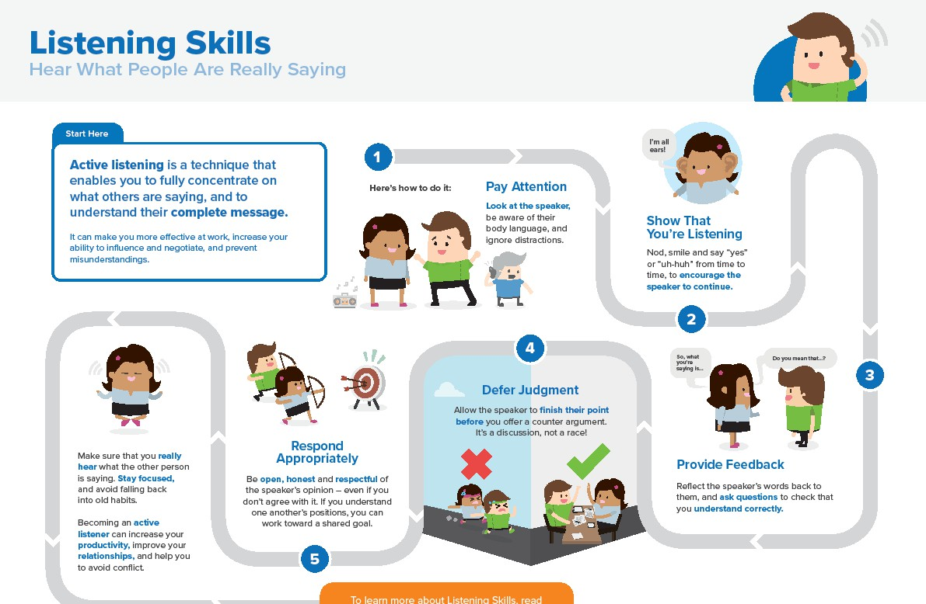

Slide 8


Group Discussion
Possible Barriers to Good Communication?

Slide 9

Barriers to Good Communication
Folded arms
Daydreaming
Tapping
Fidgeting or scratching
Rehearsing what you are going to say
Hands in pockets
Rushing
Time
Mind Reading
Wringing hands
Judging what they tell you Shouting
Being Right
Derailing
Talking too fast
Placating
Over identification
Touching your face or neck •
Advising
Looking away
Staring
Arguing with the person
Whispering
Talking too slowly
Contradicting

Slide 10

Questioning Techniques
Open and Closed Questions
An open question is a question that starts with “how”, “what”, “when”, “where”, “who” or “why” and cannot be answered with a simple “yes” or “no”.
You will likely use open questions when:
  You want to better understand your mentee
  You want to show interest in what the mentee has to say
Ask open questions as often as possible and then to follow up with a closed question when you want to confirm their understanding of something.
A closed question is the exact opposite of an open question. So these are questions to which a person can only answer “yes” or “no”.
Be wary of stacking up questions. This means asking two or more open questions at once.The person/mentee will generally only answer the last question, even though it might be of lesser importance.

Slide 11

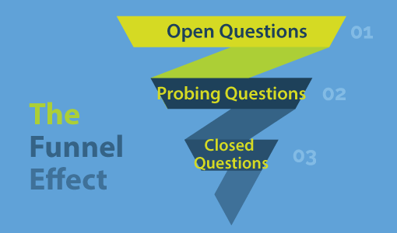
Questioning techniques
Step 1: Asking Open Questions – Try to start with open questions, as this will give you all the information you need to take the conversation further.
Step 2: Asking Probing Questions – These are the questions which will allow you to delve deeper into the customer’s answers to your open questions, finding out the reasons and emotions behind those answers. They include questions such as:
Could you give me an example of what you mean by…?
How long has this been going on?
How has this(incident) made you feel?
What happened when you tried to…?
Step 3: Asking Closing Questions – Asking closing questions allows you to confirm both your own and the mentees understanding of what has been discussed.
When you string together your questions in this fashion, they are known as funnel questions.

Slide 12
3. TED Questions – (Tell, Explain, Describe)
When using probing questions, TED : tell, explain and describe, can be very useful.
Some examples of TED questions include:
Tell me, how will that affect you?
Tell me, has this happened before?
Can you explain to me, what impact has this had on your…?
Explain to me, how did this situation begin?
Can you describe how you felt about that?
Describe your ideal outcome
It can be great to use these TED questions to probe further when the mentor feels as though they have heard something that they would like some more information

Slide 13
Now rate the listener by placing where you think they are on a scale from 1 – 5 (1 is low, 5 is high)
Can show that they are listening
Make good eye contact if appropriate
Listening Exercise Feedback
First - Supporter Second – Supported
Third - observers
3. Voice is easily
understood
4. Alter voice appropriately
5. Paraphrasing
6. Summarising
7. Giving feedback
Not showing emotions
Use a range of questioning styles
Using face to show interest

Slide 14
Submit Worksheets
Worksheets 4 a,b,c (completed in the session)
Worksheet 6 – Non-Verbal Communication
Find all of these at http://womensworkshop.net/whatweoffer
Pairing people up to practice skills outside of the training.
Organise in your own time and contact us if you would like us to set up a Zoom meeting for you.
What Next?
Next session Tues 17th March 1 – 2.30

