Slide 1



Practical and Emotional Support Skills
Session One
Women’s Workshop:
New approaches to learning and support

Slide 2


Session Outline
Welcome and introductions
  Introductions and Group agreement
  Learning styles
  Self assessment
  Definitions – group exercise
  About our organisations
  What Next?

Slide 3
Introductions
Round the group:
Say your name
Share one ‘new and good’ thing for today

Slide 4
Today’s Learning Objectives
Understand differences between information, advice or guidance.
The scope of provision of information, advice or guidance within the context of your own organisation.
Understand ways of meeting information, advice or guidance requirements of clients.
Identify your own strengths, skills and goals in interaction skills
(IAG in Practice LO 1, 2)

Slide 5

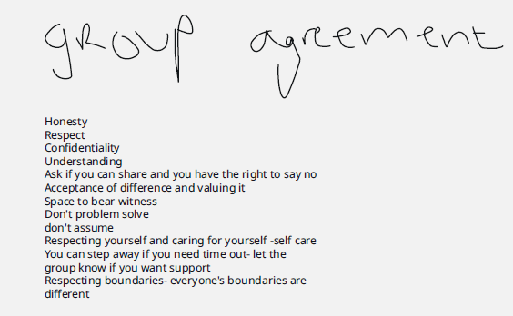
Group Agreement
Key Words to be used in a shared statement:
Inclusive
Safe
Supportive
Culturally appropriate
Equal
Heard

Slide 6
What’s Your Learning Style?
Visual - ‘show me’, ‘let’s have a look at that’
A preference for seen or observed things, including pictures, diagrams, demonstrations, displays, handouts, films, flip-chart, etc. These people will be best able to perform a new task after reading the instructions or watching someone else do it first. These are the people who will work from lists and written directions and instructions.
Auditory - ‘tell me’, ‘let’s talk it over’
Someone with an Auditory learning style has a preference for the transfer of information through listening: to the spoken word, of self or others, of sounds and noises. These people will be best able to perform a new task after listening to instructions from an expert. These are the people who are happy being given spoken instructions over the telephone, and can remember all the words to songs that they hear!
Kinaesthetic - ‘let me try’, ‘how do you feel?’
A preference for physical experience - touching, feeling, holding, doing, practical hands-on experiences. These people will be best able to perform a new task by going ahead and trying it out, learning as they go. These are the people who like to experiment, hands-on, and never look at the instructions first!

Slide 7
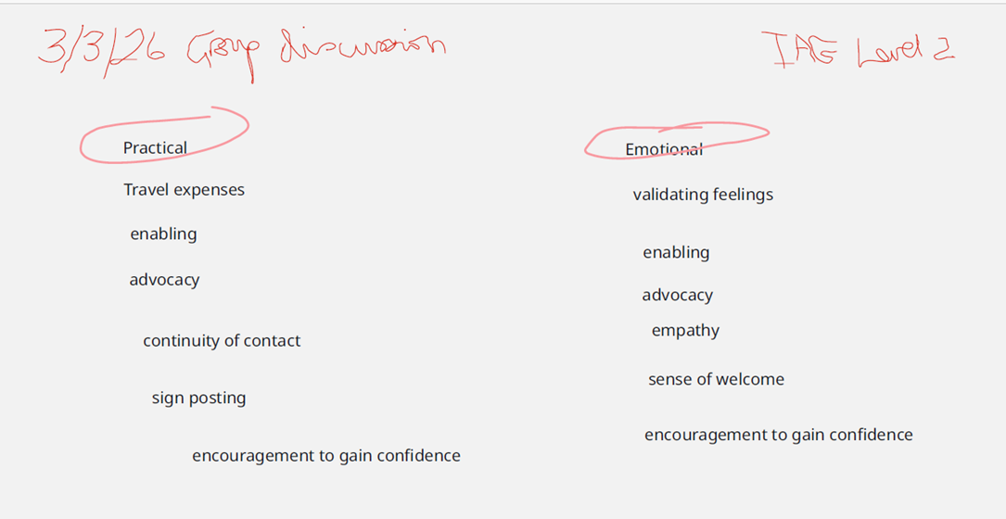
Definitions of support
What words have you heard used to describe different approaches for providing practical and emotional support? A group discussion, placing ‘practical’ towards the left and ‘emotional’ towards the right

Slide 8

What is mentoring?
Some quotes to explore…….
“Mentoring is a one-to-one, non-judgemental relationship in which an individual voluntarily gives time to support and encourage another. This is typically developed at a time of transition in the mentee's life and lasts for a significant and sustained period of time.”
Active Community Unit, Home Office
“A process where one person (the mentor) offers help, guidance, advice and support to facilitate learning or development of another person (the mentee).”
www.undp.east-timor.org
Agree?
Disagree?

Slide 9
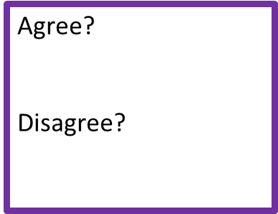
What is Peer Mentoring?
“Peer mentoring is a relationship between people who are at the same career stage or age, in which one person has more experience than the other in a particular domain and can provide support as well as knowledge and skills transfer. Peer mentoring may be a one-on-one relationship or experienced in a group. The exchange is usually mutual, even if one member of the relationship begins in the traditional role of mentee, or learner, and the other in the role of mentor.”
https://artofmentoring.net/peer-mentoring/

Slide 10
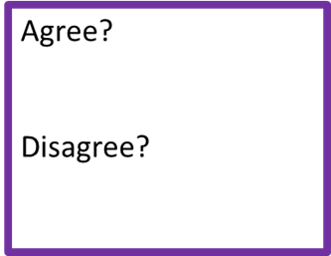

What is Giving Information?
“Providing information on learning, work or other fields without any discussion of the relative merits of the options.”
Department for Education and Skills

Slide 11

What is Giving Advice?
“More interaction with the client, usually on a one-to-one basis. It may require explanation of some of the information provided, how to access and use information, and a recognition of when more in-depth services may be required by the mentee.
  Promoting the benefits to individuals of engaging in learning and work;
  Raising awareness and motivation of users and potential users to access information on a range of activity.
  Providing people with IT support to access the information;
  Helping people to navigate the information sources to find what they need;
  Enabling people to understand the information in relation to their needs;
  Teaching people the skills to use the information effectively to manage their careers;
  Identifying barriers to effective information use and, where appropriate, signposting/referring to relevant support;”
Department for Education and Skills

Slide 12
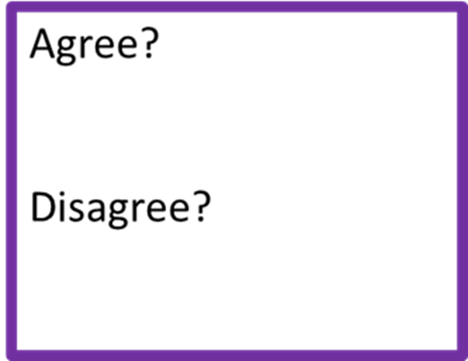
What is Guidance?
“Guidance refers to the process of facilitating individuals or groups at any point throughout their lives to develop their capacity for the self-management of their personal, social, educational, training, occupational and life choices in order to grow towards their potential and thereby to contribute to the development of a better society.”
National Guidance Forum of Eire, Dec. 2004.
Helping people
to understand their own needs relating to their situation;
to set and review goals/objectives for improving their situation;
to understand their barriers to achieving learning, work or personal development;
to overcome barriers/obstacles to learning, work and/or personal development
to produce learning, career and / or personal development action plans for review
Based on Department for Education and Skills definition

Slide 13
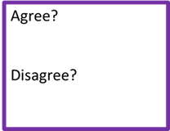

What is counselling?
“Counselling takes place when a counsellor sees a client in a private and confidential setting to explore a difficulty the client is having, distress they may be experiencing or perhaps their dissatisfaction with life, or loss of a sense of direction and purpose. It is always at the request of the client as no one can properly be 'sent' for counselling. “
The BACP definition of counselling

Slide 14
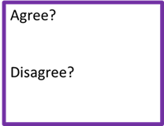
What is coaching?
“Coaching is a strategy used to help a mentee reach her fullest potential and achieve her goals. The coach first helps to define the goals, and then supports the mentee in executing them by mapping out a strategy and helping her stay on track. Coaching helps to balance work, family and social demands as well as leisure and spiritual activities.”
www.eastendhealth.com/glossary.asp

Slide 15
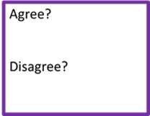
What is befriending?
“Befriending is a process whereby two or more people come together with the aim of establishing and developing an informal and social relationship…Ideally the relationship is non-judgemental, mutual, purposeful and there is commitment over time. “
Home Office

Slide 16
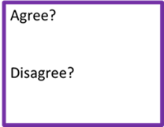
What is advocacy?
“Advocacy is taking action to help people say what they want, secure their rights, represent their interests and obtain services they need. Advocacy promotes social inclusion, equality and social justice.”
Action for advocacy
“Advocacy is something that one person does in support of another. It is about:
Safeguarding people who are in situations where they are vulnerable.
Speaking up for, or standing alongside, people who are not being heard, helping them to express their views and make their own decisions and contributions.
Enabling people to make informed choices about, and remain in control of, their own social and health care.”
Glasgow City Council

Slide 17
What is ‘trauma informed’ good practice?
“Trauma-informed good practice is an approach across health, education, and social services that recognizes the widespread impact of trauma, aiming to prevent re-traumatisation by prioritizing safety, trust, and empowerment. It shifts the focus from "What is wrong with you?" to "What happened to you?“
Trauma-Informed Good Practice
Shifting Communication: Asking "What has happened to you?" instead of "What have you done?" when managing behaviour.
Environmental Safety: Ensuring physical and emotional safety in spaces, such as creating quiet, non-triggering environments in offices or clinics.
Transparent Procedures: Explaining procedures clearly and honoring commitments to build trust.
Empowering Choice: Providing service users with control over their care, treatment, and decisions.
Empathetic Language: Using respectful, non-judgmental language that avoids blaming.
Staff Wellbeing: Offering supervision, training, and support to prevent vicarious trauma in practitioners. (NHS Scotland)

Slide 18
Practical and Emotional Support is NOT…
Doing someone else’s job for them
Knowing all of the answers all of the time
Imposing ready-made solutions that worked somewhere else
Being brilliant at doing whatever the learner wants to do
Importing and applying hi-tech and perhaps culturally inappropriate solutions
www.undp.east-timor.org

Slide 19
IAG in your organisation or community
Take it in turns to ask the other person:
What kind of issues are people asking for help with?
(Questioner - make a list for the person who is talking)
Give some (anonymous) examples of different people who may have each of these needs, and say why (questioner, help this to get written down if required):
  Information
  Information and Advice
  Information Advice and Guidance
How would they get that within your organisation?
Share how that felt to talk it through.

Slide 20
Stages of the Mentoring Relationship
Aim to put the following steps into the right sequence by putting a number next to each one (1 for the first step, 2 for the second etc)
Setting goals
Identifying Skills, Achievements, Interests
Agreeing a Contract
Reviewing progress
Exploring current situation
Explaining what’s on offer
Action planning
Creating a welcoming environment
Celebrating outcomes
Identifying support needs
Introducing yourself
Looking at blocks and barriers
Prioritising goals

Slide 21
Individual Support Plan
Look through it
Start to use it by supporting your peer learner to complete it
Set up a welcoming environment

Slide 22
What Next?
Before we meet again next week, please complete:
Worksheet 1 – Definitions
Worksheet 2 – Skills Audit
Worksheet 3 – IAG in your organization
Worksheet 8 – Stages of the P&E relationship
Session Review sheet
Work with your peer learner if you would like to!
Learning Mentor will be assigned if required and will be in touch with you to:
  Sort out how you can access the resources you need
  Check you have IT in place to take part e.g. equipment, access to Wi-Fi
  Check your understanding of the homework tasks which will be emailed or posted to you
  Next Session Tues 10th March 1-2.30 / evening

Slide 23

Assessing your learning
  Copies of worksheets and handouts are downloadable on the Women’s Workshop website at www.womensworkshop.net/what-we-offer
  All completed work can be returned to Julia at info@womensworkshop.net or by hand or post to Women’s Workshop, Fourways 2, Dilston Terrace, Amble NE65 0DA
  Observations will be organised with each pair of learners, in person or online

Slide 24

Any questions thoughts or comments?

