Slide 1



Practical and Emotional Support Skills
Policy into Practice Access, Boundaries, Safety
Women’s Workshop:
New approaches to learning and support

Slide 2

Introductions
Round the group:
One thing you are particularly looking forward to, personally or in your work.
Please chose someone else to speak next.

Slide 3

Session Outline
Welcome
  Feedback on practice so far and the Individual Support Plan
  Quality Assurance Framework
    Boundaries
    Confidentiality and Data Protection and good practice guidelines.
    Safety and Risk Pt1
  What Next?

Slide 4
Today’s Learning Objectives
Developing Interaction Skills for IAG:
1.1. Describe an appropriate model for interactions with individual clients.
1.2. Give reasons for using a structured approach for interactions.
1.3. Describe how to reach a shared agreement with clients.
4.1 Describe how principles of confidentiality and data
protection are adhered to in interaction with clients.
Mentoring Skills
1.2. Define the records that need to be kept regarding an ongoing mentoring relationship.

Slide 5
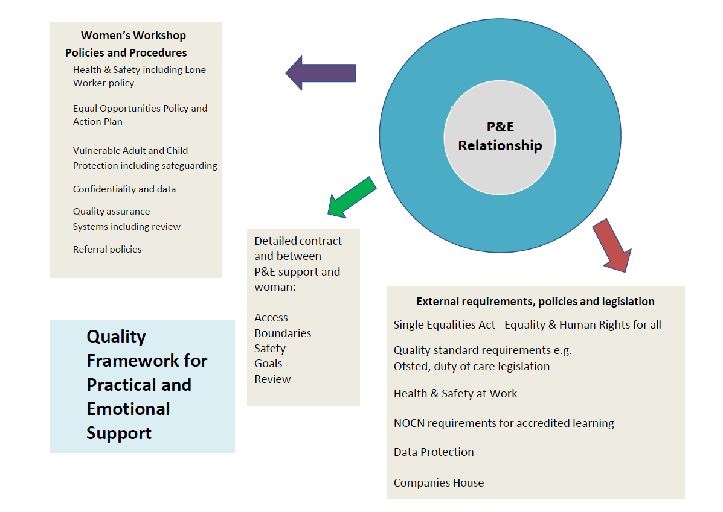

The framework for safe and inclusive good practice in P&E support
Three layers…
Organisational policies
Individual contract
Legal requirements

Slide 6
Establishing a Personalised Contract in a Mentoring relationship
Negotiate:
  Access
  Boundaries
  Risk
Contract

Slide 7

Access
Women’s Workshop
WW Equality and Diversity Policy and Action Plan
WW Values Statement
WW Learner Charter
External Requirements
Equalities Act
Funders
P&E Support Service
Support agreement
Adaptations
Reaching out
Discrimination aware
Empowering women to challenge

Slide 8
Paperwork - Individual Support Plan…..
Who’s it for?

Slide 9

What’s covered in the ISP
Setting up the support framework (pages 2-5)
Exploring their current situation (pages 6-8)
Building on strengths to create goals (pages 9 – 11)
Finding out more about resources and other agencies (page 12)
Review (page 13)
Notes sheet for P&E supporter (page 14)
Mapping support and referral network at the end of the process (page 15)

Slide 10

What are Boundaries?
Boundaries are designed to protect and honour important parts of our lives. They are created to clarify what are acceptable and unacceptable behaviours from others and ourselves.
Key Areas to Protect Using Boundaries
There are several key areas of our lives that should be protected by personal boundaries. Explore how you see your own issues in the following areas and say how that will impact on your role as a P&E supporter:
Time
Emotions
Energy
Personal Safety
Personal Values or Other Areas of Importance to You
Skills and expertise

Slide 11

Scenario
Margaret (43)
You were originally contacted by mother, Margaret, for support while her daughter with a learning disability, Poppy, settles into her own supported housing. Margaret has a lot of issues:
Coercive relationship – a new partner has moved in and doesn’t contribute
Poor mental health linked to past trauma
Not managing financially
Money on drugs for partner and sometimes herself
Prone to crisis
Difficult relationship with Poppy
Can seem to be exploiting the help that’s offered
In one week, she asks for: a lift to Newcastle for emergency dental surgery; basic provisions because she misses food bank opening hours; plates and towels for Poppy; top up for gas which has been cut off; cat food; money.
What are the issues for:
Access / Boundaries / Safety

Slide 12
Scenario
Poppy, 23
Poppy, a young woman with partly diagnosed learning disabilities has agreed for you to support her while she gets established living independently for the first time. She finds it difficult to organise her time, and finds everyday things, like managing money, cooking, keeping appointments a bit challenging. She has recently got concerned that her neighbour is disrespecting her and complaining to housing services, and this is causing her some anxiety.
She is very keen to work but doesn’t know whether she will lose all of her benefits if she does. She wants to take up learning opportunities but has sometimes struggled to finish courses and needs support with written work. She gets a bit low at times and thinks medication might help. She would like a relationship and sometimes looks at internet dating sites but doesn’t feel very confident about it.
What are the issues for:
Access / Boundaries / Safety?

Slide 13
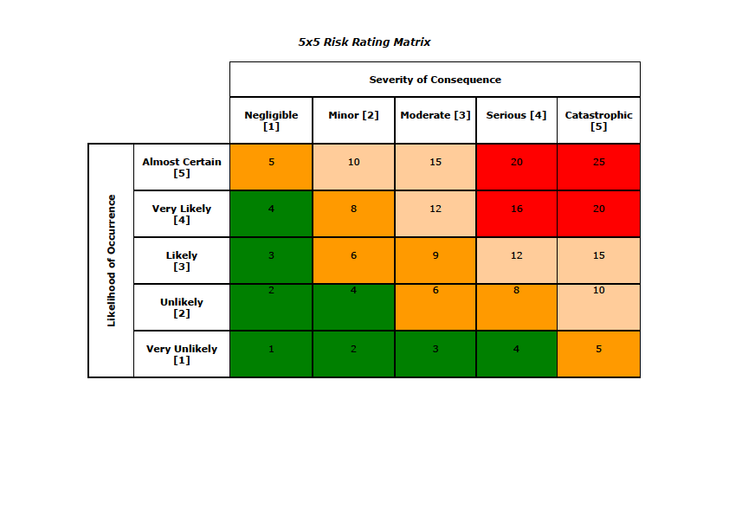
Possible Risks | Likelihood | Consequence | Rating | Risk Control
For the individual
For her mentor
For other women
For staff and volunteers
Risk and Safety

Slide 14
20 Decide to end P&E supportrelationship / crisis refer / report
15 Put limits on where, when and how to engage with her
10 – 12 Maintain involvement but develop detailed plans to ensure her safety, P&E supporter safety and others
5-9 Report risk incident / concern to Lead Support Worker for action including safeguarding action if needed
1-4 Identify named P&E Supporter with responsibility for assessing safety with and by client in all WW settings
All scores - Agree general safe systems of work for staff vols and clients for each activity by carrying out activity risk assessment

Slide 15

Confidentiality
Information should:
Be obtained fairly and lawfully
Held for a clear, explicit purpose
Be adequate, relevant and not excessive for that purpose.
Accurate and kept up to date.
Kept no longer than necessary for the specific purpose.
Made available to the person on request, subject to access.
Properly protected from loss or unlawful disclosure.

Slide 16
The framework for safe and inclusive good practice in P&E support
Three layers…
Organisational policies
Individual contract
Legal requirements

Slide 17
Women’s Workshop Policies and Procedures
Health & Safety
Lone Working
Equal Opportunities
Vulnerable Adult Protection
Confidentiality
Risk Assessment
Quality assurance systems
P&E Support Handbook
Referral Systems
In your Centre information folder
On our website

Slide 18
External requirements, policies and legislation
Single Equalities Act
Human Rights
Duty of care legislation
NOCN requirements for accredited learning
Data Protection
Companies House
We will share all relevant issues throughout the course

Slide 19

Record Keeping
Describe what records are used within WW or within your organisation. If you don’t know think about what should be kept.
How are records kept or who is responsible for different records?
What is the purpose of record keeping?

Slide 20
What Next?
Worksheet 5 - Boundaries
Worksheet 7 - Case Studies
Worksheet 9 - Paperwork
Find all of these at http://womensworkshop.net/what-we-offer
Tutorial sessions are available to:
  Sort out how you can access the resources you need
  Check your understanding of the homework tasks which will be emailed, posted or you can access through our website
  Next - Signposting and Referral

Slide 21


Any questions thoughts or comments?

